Slide 1
Financial Management
Lecture 8: Valuing Bonds and Shares

Slide 2
PART 1: Interest rates, bill and bond valuation

Slide 3
Introduction
We focus on debt instruments in this part
Debt is where a company borrows money, which it will repay at some future time.
Debt is given different names, depending upon how long the borrowing period is. Very broadly:
Bills – short term (less than a year)
Notes – medium term (1-10 years)
Bonds – long term (can be for longer than 10 years)
Notes:
Borrow from the bank or by issuing bond

Slide 4
Bills of exchange
A bill is a written order requiring one person to pay a fixed sum of money to another at a future date (maturity)
The face value is the amount to be repaid at the end of the term (also called par value)
There are no interest payments for a bill
Notes:
Remember that companies are legal “persons”

Slide 5
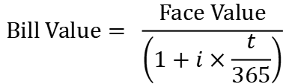
Bill values and yields
If a bill has:
a face value is paid at maturity
t periods to maturity; and
a yield of i per period
$$\text{Bill} \text{Value}= \frac{\text{Face} \text{Value}}{\left(1+i×\frac{t}{365}\right)}$$
Notes:
Yield is the rate required in the market.
Point out that the face value of the bill always remains the same. The present value of the bill equals the face value at maturity.
THIS IS A SIMPLE INTEREST FORMULA. No exponents – just multiply rate times fraction of year.

Slide 6
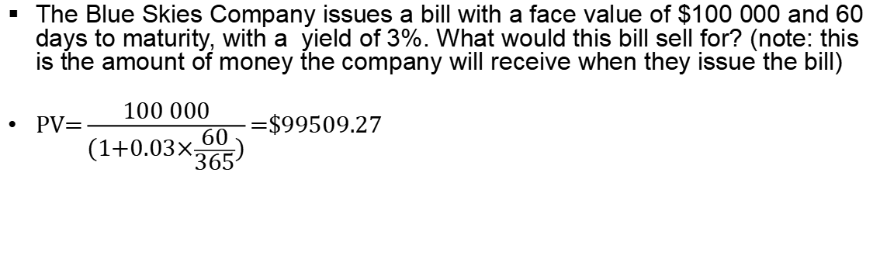
Bill pricing—Example
The Blue Skies Company issues a bill with a face value of $100 000 and 60 days to maturity, with a yield of 3%. What would this bill sell for? (note: this is the amount of money the company will receive when they issue the bill)
$\text{PV}\text{=}\frac{\text{100} \text{000}}{\text{(}\text{1}\text{+}\text{0}\text{.}\text{03}\text{×}\frac{\text{60}}{\text{365}}\text{)}}\text{=\$}\text{99509}\text{.}\text{27}$
Notes:
Point out this is the value that the company will receive on issuing the bill.

Slide 7
More on bill features
Three parties to a bill of exchange:
1. The drawer - wants to borrow the funds and is required to sign the face value of the bill.
2. The acceptor - agrees to pay the face value of the bill at maturity e.g. a bank.
3. The discounter (or endorser) - initially lends the funds and purchases the bill.
The amount of funds the drawer will receive depends on the face value of the bill and the prevailing market rates (discount rate).
The original discounter may hold the bill to maturity or sell it in the market before the maturity date.
At the maturity date, the current holder of the bill will approach the acceptor for repayment. The acceptor is liable to pay the face value of the bill to the current holder and will recover the money from the drawer.
Notes:
Bank Bills:
Bill of exchange that has been accepted or endorsed by a bank
Non-bank Bills:
Any bill of exchange that has been neither accepted nor endorsed by a bank

Slide 8
Issuing Bills of Exchange
Money
Drawer
bill accepted (guaranteed)
Acceptor
Discounter
Bill (promise to pay)
Notes:
Students to fill in the boxes
1. The drawer - borrower.
2. The acceptor - agrees to pay the face value of the bill at maturity eg a bank.
3. The discounter (or endorser) - lender

Slide 9
Selling Bills of Exchange
Re-discounter
(Buyer)
Money
(PV of Face Value)
Discounter
(Seller)
Bill (“endorsed”)
Notes:
The discounter has the choice of either holding the bill until maturity, when payment will be received from the acceptor, or selling (rediscounting) the bill. However, if the bill is sold, the seller normally endorses the bill at the time of sale.
Endorsement:
acceptance by the seller of a bill in the secondary market, of responsibility to pay the face value if there is default by the acceptor, drawer and earlier endorsers.

Slide 10
Bills of Exchange: Repayment
Presents Bill for repayment
Drawer
Presents Bill for repayment
Acceptor
Face Value
Current Holder
Face Value
Notes:
The acceptor has the initial obligation to pay the holder of the bill at maturity. The acceptor will then approach the drawer for repayment.
In the unlikely event that the acceptor is unable to pay the holder, the holder approaches first the drawer, then, if the drawer is unable to pay, each endorser becomes liable to subsequent holders of the bill. Therefore, endorsement of the bill constitutes a contingent liability.

Slide 11
Bond definitions
In contrast to bills, bonds are long term debt contracts that represent claims against a company’s assets.
They work like an interest-only loan
The interest income paid to investors is fixed for the life of the contract – why they are called fixed-income securities.

Slide 12
Corporate bonds
Only a small number of the existing bonds actually trade on single day
http://www.asx.com.au/asx/markets/interestRateSecurityPrices.do?type=CORPORATE_BOND
Result: corporate bond market is thin (illiquid) compared to market for money market securities or corporate shares
Corporate bonds are less marketable than securities with higher daily trading volumes (e.g. shares)
Prices in corporate bond market also tend to be more volatile than securities sold in market with greater trading volumes

Slide 13
Corporate bonds
Largest investors in corporate bonds are superannuation funds, investment funds and life insurance companies
Trades in this market tend to be in very large blocks of securities
Most secondary market corporate bond transactions take place through dealers in the over-the-counter (OTC) market.
Corporate bond market not considered very transparent - difficult for investors to view prices, trading volume
Further, many corporate bond transactions are negotiated between buyer and seller; there is little centralised reporting of these deals

Slide 14
Coupon bonds
Coupon bonds pay fixed interest over the life of the bond
At maturity, principal is paid and bonds are retired
Features are as follows:
FV
CPN
CPN
CPN
CPN
CPN
CPN
CPN
CPN
CPN
…
0
1
2
3
4
5
n-3
n-2
n-1
n

Slide 15
Key features of a bond
Face value:
Also called par value
What borrower will repay at maturity
Assume $1000 for corporate bonds unless otherwise specified
Coupon payments:
Interest payments on bonds are called “coupons”
The coupon rate is the rate at which coupons are paid
Coupon amount is coupon rate*face value
If not stated, assume bonds pay coupons twice per year and coupon rate is an APR that compounds semi annually

Slide 16
Key features of a bond (cont.)
Maturity:
Time at which bond must be repaid
Yield to maturity (YTM):
Sometimes simply called the “yield” for short
The market required rate of return for bonds of similar risk and maturity
The discount rate used to value a bond
Return if bond held to maturity
Quoted as an APR

Slide 17
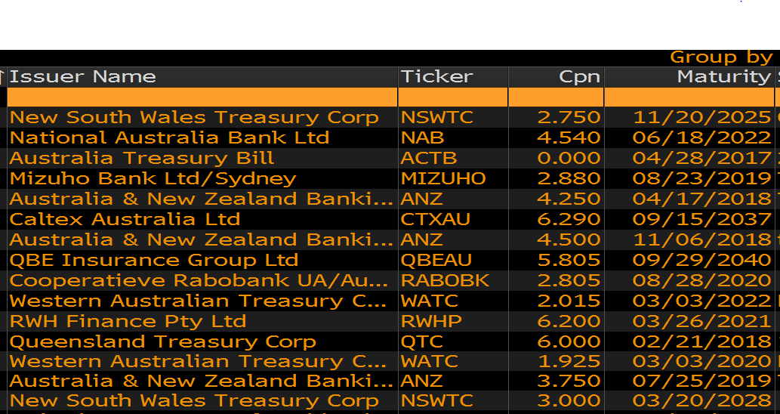
Key features of a bond (cont.)
Notes:
Some bonds from Bloomberg = coupon and maturity shown

Slide 18
Bond Pricing
Cash flows of a bond comprise:
Regular interest payments of:
CPN = FV × (coupon rate) ÷ (# coupons per year)
Number of coupon payments:
n = (# coupons per year) × (# years)
Payment of face value at maturity
FV
CPN
CPN
CPN
CPN
CPN
CPN
CPN
CPN
CPN
…
0
1
2
3
4
5
n-3
n-2
n-1
n
Notes:
What is this?
An annuity plus a lump sum → how to price?

Slide 19

The bond-pricing equation
The price of a bond, like any other financial instrument, is the present value of its future cash flows:
where,
CPN = Coupon payment;
i = Yields to Maturity (YTM)
n = Number of Payments
Notes:
As interest rates increase present values decrease ( r → PV  ).
As interest rates increase, bond prices decrease and vice versa.
Often coupons are paid semi-annually. In this case we need a semi-annual cashflow and a semiannual rate. Note that bond rates are APRs so we can just divide the rate by 2 to get the semiannual rate

Slide 20
Semi-annual bonds - Example
What is the price of a bond which pays a 7% coupon semi-annually. Its yield to maturity is 8% and it will mature in 8 years.
First, work out
Number of coupon payments = = 2 x 8 years = 16
Semiannual coupon payment = (7% x face value)/2= $35
Semiannual yield (YTM) = 8%/2 = 4%
Bond price?
$=35×\left[\frac{1−{(1+0.04)}^{−16}}{0.04}\right]+\frac{1000}{{(1+0.04)}^{16}}$ = $941.74
Notes:
Note the rate is not stated as a semi-annual rate. However, we assume that it is an APR of 8% p.a. compounding semiannually.

Slide 21

Zero coupon bonds
Companies sometimes issue bonds with no coupon payments, only offering one payment at maturity
Consequently, to price a zero coupon bond, we just use an application of the present value of a lump sum formula
Zero coupon bonds sell well below their face value (at a deep discount) because they offer no coupons
Not frequently issued in Australia

Slide 22

Zero Coupon bonds – YTM Example
Suppose that a one-year, risk-free, zero-coupon bond with a $100,000 face value has an initial price of $96,618.36. What is the yield to maturity of the bond?
The cash flows would be:
0
1
−$96,618.36
+$100,000
$\text{96}\text{,}\text{618}\text{.}\text{36}=\frac{\text{100}\text{,}\text{000}}{{(1+YTM)}^{1}}$
$$YTM=3.5\%$$
Notes:
Note the rate is not stated as a semi-annual rate. However, we assume that it is an APR of 8% p.a. compounding semiannually.

Slide 23
Bond yields
A bond’s yield to maturity is the discount rate that makes the present value of coupon and principal payments equal to the price of the bond
It is the yield that the investor earns if the bond is held to maturity, and all coupon and principal payments are made as promised
A bond’s yield to maturity changes daily as interest rates increase or decrease.

Slide 24


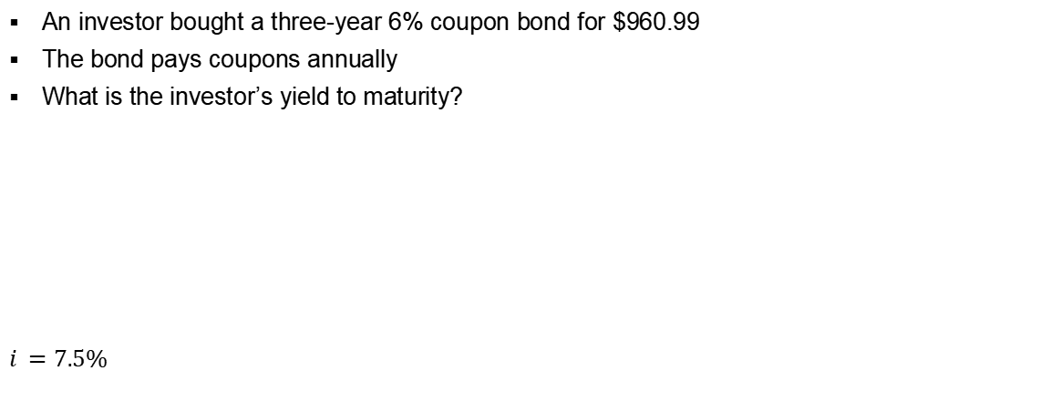
Coupon Bonds – YTM Example
An investor bought a three-year 6% coupon bond for $960.99
The bond pays coupons annually
What is the investor’s yield to maturity?
$i =7.5\%$
$$\$960.99=60\left[\frac{1−{(1+i)}^{−3}}{i}\right]+\frac{1000}{{(1+i)}^{3}}$$

Slide 25
Pricing between coupons
Remember that the present value of an annuity formula will give you the value one period before the first cash flow
What about if you purchase the bond in between coupon payments?

Slide 26
Example: Adelaide Bank
Pays coupons of 8.4%
Matures end of June 2020
Pays interest quarterly
Face value is $100
If you require a return of 7.5%, what would you pay for this note?
Value the note as at end of August 2016
Notes:
Note frequency of coupons = quarterly. Assume rate is APR compounding quarterly

Slide 27
Adelaide Bank
How many more coupons?
When was the most recent coupon paid?
When is the next coupon payment?
How much is each coupon?
What is the periodic yield?
At what point in time does our bond formula compute the value?
How can we adjust this?
16
June 2016
Sep 2016
$2.10
1.875%
Just after last coupon (June 2016)

Slide 28
Example: Adelaide Bank
$100
Draw a timeline here:
Hints: this bond is priced between coupons
When you are drawing your timeline, it is best to start at maturity and work backwards to today
The first cash flow you should draw on your timeline is the maturity value, then put in the prior coupon, then the coupon before that and backwards sequentially – this will help you to work out what n should be
$2.1
$2.1
$2.1
$2.1
$2.1
$2.1
$2.1
$2.1
$2.1
…
Jun 2016
Sep 2016
Dec 2016
Mar 2017
Jun 2017
Sep 2017
Sep 2019
Dec 2019
Mar 2020
Jun 2020
Notes:
How to calculate the no. of payments?

Slide 29
Working Spaces:
At what point in time is this? June 2016
We need to value the bond at end of August 2016
How? We need to compound it for two months
Remember that cash flows are quarterly
How many months are there in a quarter? So what fraction of a quarter is two months?

Slide 30
Bond Relationship I: Coupon rate vs. Yields to Maturity
A bond’s coupon rate = yield to maturity, bond will sell at price equal to its face value; these are called par bonds.
A bond’s coupon rate is < yield to maturity, then bond will sell at price less than its face value; these are called discount bonds
A bond’s coupon rate > yield to maturity, then bond will sell at price more than its face value; these are called premium bonds
Notes:
Think about the coupon vs the rate in the market – eg coupon is 7% YTM is 9% (YTM>coupon)means investors are getting 7% for the bond (in coupon payments), but they could get 9% elsewhere in the market – so they will want to pay less than FV for this bond (price<face value)

Slide 31
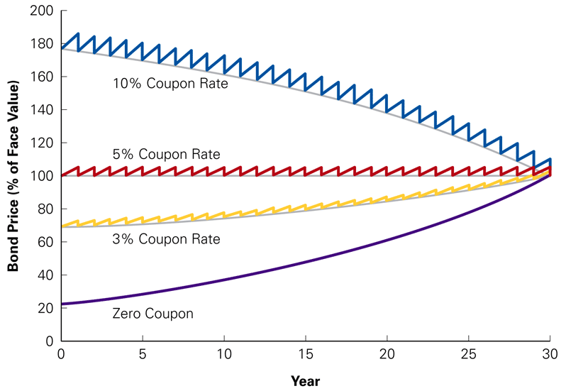
Bond Relationship II: Effect of Time and Bond Price
Holding all other things constant, the price of discount or premium bond will move towards par value over time.

Slide 32
What Affect Yields?
The yields on corporate bonds are determined by the riskiness of the company issuing the bond (its ability to repay) and also the characteristics of the bond
There are four risk characteristics that are responsible for most of the differences in corporate borrowing costs:
Security’s marketability
Call feature
Default risk
Term to maturity

Slide 33
The structure of interest rates
Marketability is an investor’s ability to sell a security quickly at low transaction cost, and at its fair market value (liquidity)
Question: There are two bonds A and B. The bonds have the same features (coupons rate, maturity etc). However, bond A is more marketable than bond B. Which bond would you prefer? Which bond would you be willing to pay more for? What does this mean about the yield?
You would prefer the more marketable bond – bond A
Therefore would pay more for bond A
Therefore the yield would be lower (remember: inverse relation between yield and price)

Slide 34
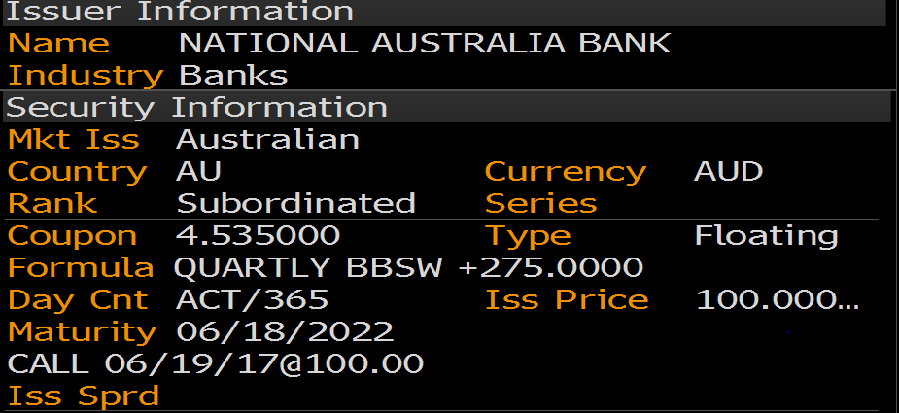
The structure of interest rates
Call Provision gives the company issuing the bonds the option to purchase the bond from an investor at a predetermined price (the call price)
Investor must sell the bond at that price
Notes:
When is this bond callable and at what price?
Callable on 19 June at face value (quote is a percentage)

Slide 35
The structure of interest rates
Question: there are two bonds C and D. The bonds have the same features (coupons rate, maturity etc). However, bond C is callable. Which bond would you be willing to pay more for? What does this mean about the yield?
When bonds are called, investors suffer financial loss because they are forced to surrender their high-yielding bonds and reinvest their funds at lower prevailing market rate of interest
Therefore investors do not like callable bonds – prefer bond D
Bond D’s price will be higher and yield will be lower
Notes:
When do you think companies would recall bonds? When the bond is “expensive” for the company to maintain
Eg bond has coupon of 7% but interest rates are 5%→ likely to be called, because the company can refinance at the lower rate
(for the investor, losing a valuable 7% rate, and they would only be able to purchase a new security at the lower 5% rate)
If interest rates were 9% → wouldn’t be recalled – bond is cheap compared to current market rates

Slide 36
The structure of interest rates
Default Risk is the risk the that the lender may not receive payments as promised
Question: there are two bonds E and F. The bonds have the same features (coupons rate, maturity etc). However, bond F is more likely to default. Which bond would you be willing to pay more for? What does this mean about the yield?
Would be willing to pay more for bond E - investors must be paid a premium to purchase a security that exposes them to default risk
Bond E would have a lower yield

Slide 37
Bond ratings
Individuals and small businesses must rely on outside agencies for information on the potential that a bond issuer may default
Two most prominent credit rating agencies: Moody’s Investors Service (Moody’s) and Standard & Poor’s (S&P)
Both credit rating services rank bonds in order of expected probability of default; publish ratings as letter grades
Fitch is a third widely-used credit ratings agency

Slide 38
Bond ratings
Highest grade bonds, those with lowest default risk, are rated Aaa (or AAA)
“Investment grade bonds”, those in the top four rating categories, are rated Aaa (AAA) to Baa (BBB)
Some laws require banks, insurance companies, superannuation funds, other financial institutions, government agencies to purchase only investment grade securities
Speculative Bonds (BB – D)
Also known as Junk Bonds or High-Yield Bonds

Slide 39
The structure of interest rates
The term structure of interest rates is the relationship between yield and term to maturity
Yield curves depict graphically how market yields vary as term to maturity changes
Shape of yield curve is not constant over time
As the general level of interest rises and falls over time, yield curve shifts up and down and has different slopes

Slide 40
The structure of interest rates
Three basic shapes (slopes) of yield curves in the marketplace:
Ascending or normal yield curves are upward sloping yield curves that occur when the economy is growing
Descending or inverted yield curves are downward sloping yield curves that occur when economy is declining or heading into recession
Flat yield curves imply interest rates are unlikely to change in near future

Slide 41
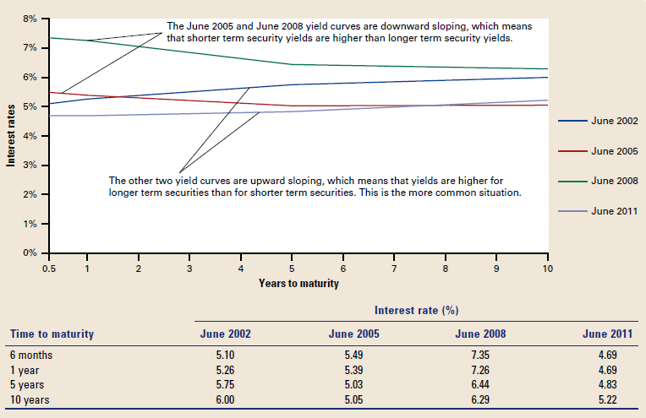
Australian zero-coupon yield curve at four different points in time

Slide 42
Convertible bonds
Bonds that can be converted into ordinary shares at a pre-determined ratio at the discretion of the bondholder
Convertible feature allows bondholders to share company’s good fortunes if the company’s shares rise above certain level
Conversion ratio is set so company’s share price must appreciate 15%-20% before it is profitable to convert bonds into equity
To secure this advantage, bondholders willing to pay a premium

Slide 43
PART 2: Share valuation

Slide 44
Ordinary shares
High-risk investments
Higher expected returns
Voting rights
Limited loss liability, unlimited return potential
From the company’s perspective:
can be useful to avoid paying a dividend
cost of financing can be high over the long term
paying dividends does not bring any tax relief, making $1 of dividend more expensive than $1 of loan interest
Shareholders
1
2
…
N-1
N
Company
Assets

Slide 45
Valuing shares
Investors make a return on their shares from two types of cash flows:
Dividends received over the life of the share
Capital gains – the difference between what the share is bought and sold for
Just like for any asset, the price of a share is the present value of its future cash flows, i.e., the present value of the dividends and the eventual sale price

Slide 46
Types of equity securities
Valuing a share is more difficult than valuing a bond because:
In contrast to coupon payments on bonds, the size and timing of dividend cash flows are less certain
Ordinary shares are true perpetuities in that they have no final maturity date.
Unlike rate of return (yield) on bonds, rate of return on ordinary shares cannot be observed directly.
There is a very famous finance model called the Capital Asset Pricing Model (CAPM). This is used to calculate the required return for an equity investment, based on, amongst other factors, the share’s risk.
We will examine this model later in the course. For this seminar we will tell you the discount rate, or assume we can back it out given the current price.
Notes:
In this lecture we are going to show you how to value a share using some simplifying assumptions e.g., we know what the dividend and timing is, we know the discount rate

Slide 47
One-period example
Suppose you are thinking of purchasing the stock of Moore Oil Ltd.
You expect it to pay a $2 dividend in one year.
You believe you can sell the stock for $14 at that time.
You require a return of 20% on investments of this risk. Note that this rate is called the return on equity
What is the maximum you would be willing to pay?

Slide 48
One-period example (cont.)
D₁ = $2 dividend expected in one year
R = 20%
P₁ = $14
CF₁ = $2 + $14 = $16
Compute the PV of the expected cash flows
This is simply a PV of a lump sum paid in one period

Slide 49
One-period example (cont.)
If we know the current and future price of the share and only one dividend is paid, at the same time as the share is sold, we can back out the return (called the return on equity)

Slide 50
Two-period example
What if you decide to hold the share for two years?
In addition to the dividend in one year, you expect a dividend of $2.10 and a share price of $14.70 at the end of year 2. Now how much would you be willing to pay?

Slide 51
Three-period example
What if you decide to hold the stock for three years?
In addition to the dividends at the end of years 1 and 2, you expect to receive a dividend of $2.205 at the end of year 3 and a share price of $15.435.
Now how much would you be willing to pay?
Notes:
What do you notice about the price? It is always the same regardless of when we think we would sell the share

Slide 52
Developing the model
You could continue to push back when you would sell the share.
In the extreme, you could assume that you never sell the share, so the only cash flow would be the dividend
Another way of thinking about this is the longer you hold it the less value the selling price has in today’s dollars.
You would find that the price of the share is really just the present value of all expected future dividends
This is called the Dividend Discount Model (DDM) because we are discounting future dividends

Slide 53
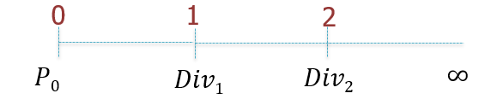

Dividend discount model
$$P_{0}=\frac{Div_{1}}{1+r_{e}}+\frac{Div_{2}}{{\left(1+r_{e}\right)}^{2}}+… =\sum_{n=1}^{∞}{\frac{Div_{n}}{{\left(1+r_{e}\right)}^{n}}}$$
The stock’s discount rate, r_{e}, is the rate of return equity investors can expect to earn on securities with similar risk.
How can we estimate all future dividend payments?
There are three general methods, depending on the form of the dividend payments

Slide 54
Estimating dividends: Special cases
Constant dividend
The firm will pay a constant dividend forever
Example: preference shares
The price is computed using the perpetuity formula
Constant dividend growth
The firm will increase the dividend by a constant percentage every period
Supernormal growth
Dividend growth is not consistent initially, but settles down to constant growth eventually
Example: during the early part of their lives, very successful companies experience a very high rate of growth in earnings, but this eventually decreases to a normal rate

Slide 55
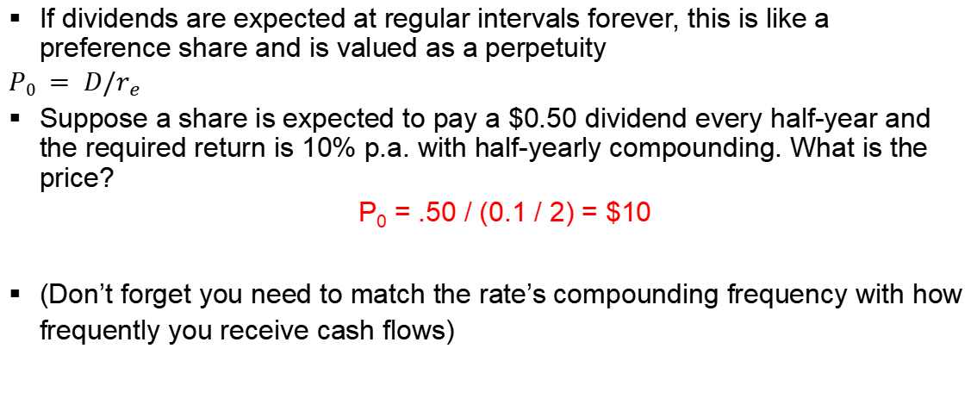
Constant (zero) growth
If dividends are expected at regular intervals forever, this is like a preference share and is valued as a perpetuity
$P0 = D/r_{e}$
Suppose a share is expected to pay a $0.50 dividend every half-year and the required return is 10% p.a. with half-yearly compounding. What is the price?
P₀ = .50 / (0.1 / 2) = $10
(Don’t forget you need to match the rate’s compounding frequency with how frequently you receive cash flows)
Notes:
Remind students to adjust the rate to the period, i.e. if the dividend is paid quarterly then the discount rate must be a quarterly rate.
Here D1=D2=D3=... D = constant.

Slide 56

Constant growth stock
As forecasting dividends is difficult, to simplify situation we incorporate certain assumptions to the pattern of dividends. The simplest forecast for the firm’s future dividends states that they will grow at a constant rate, g, forever.
Div₀ = Dividend JUST PAID
Div₁ to Div_{t} = Expected dividends
Div₁ = D₀(1+g)¹
Div₂ = D₀(1+g)²
Div_{t} = D₀ (1+g)^{t}
0
1
2
3
P₀
Div₁
Div₁(1+g)
Div₁(1+g)²
$$P_{0}=\frac{Div_{1}}{r_{e}−g}$$

Slide 57
Example 1
Suppose Outback Ltd just paid a dividend of $0.50. It is expected to increase its dividend by 2% per year. If the market requires a return of 15% on assets of this risk, how much should the share be selling for?
D₀= $0.50
g = 2%
R = 15%

Slide 58
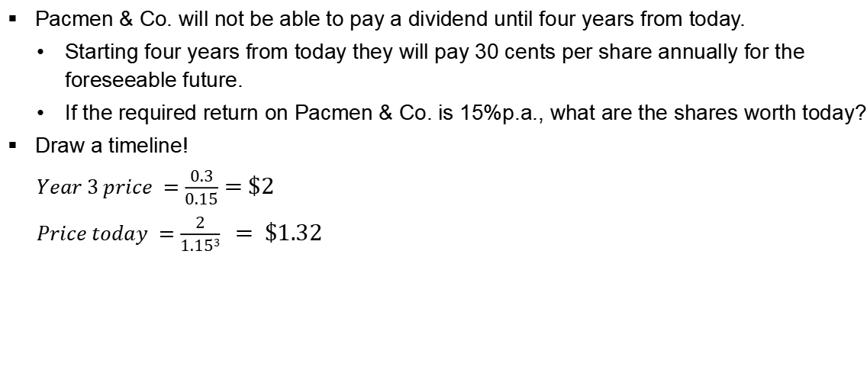
Example 2
Pacmen & Co. will not be able to pay a dividend until four years from today.
Starting four years from today they will pay 30 cents per share annually for the foreseeable future.
If the required return on Pacmen & Co. is 15%p.a., what are the shares worth today?
Draw a timeline!
$Year 3 price =\frac{0.3}{0.15}=\$2$
$Price today =\frac{2}{1.153} = \$1.32$
Notes:
Show that divs start in year 4 = PV will give price at year 3

Slide 59

Constant Dividend Growth - Multistage
Dividend-Discount Model with Constant Long-Term Growth after N
0
1
2
N
N+1
N+2
N+3
–P₀
Div₁
Div₂
Div_{N} +P_{N}
Div_{N+1}
Div_{N+1} ×(1+g)
Div_{N+1} ×(1+g)²
$$P_{N}=\frac{Div_{N+1}}{r_{e}−g}$$
Terminal price
$$P_{0}=\frac{Div_{1}}{1+r_{e}}+\frac{Div_{2}}{{\left(1+r_{e}\right)}^{2}}+…+\frac{{Div}_{N}}{{\left(1+r_{e}\right)}^{N}}+\left(\frac{Div_{N+1}}{r_{e}−g}\right)\frac{1}{{\left(1+r_{e}\right)}^{N}}$$

Slide 60
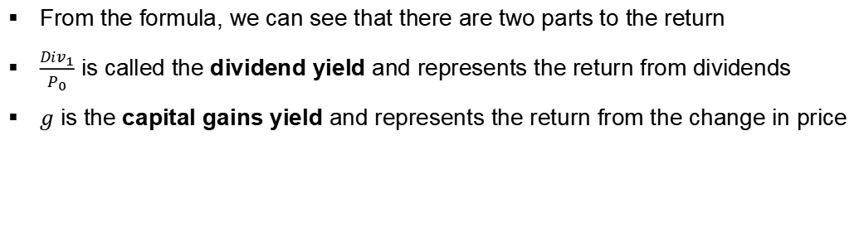


Using the DGM to find $r_{e}$
We can back out the return on equity from the formula and solve for :
$$P_{0}=\frac{Div_{1}}{r_{e}−g}$$
$$r_{e}=\frac{Div_{1}}{P_{0}}+g$$
From the formula, we can see that there are two parts to the return
$\frac{Div_{1}}{P_{0}}$ is called the dividend yield and represents the return from dividends
$g$ is the capital gains yield and represents the return from the change in price

Slide 61



Example
Suppose a firm’s shares are selling for $10.50. They just paid a $1 dividend and dividends are expected to grow at 5% per year. What is the required return?
What is the dividend yield?
What is the capital gains yield?
$$r_{e}= \frac{1×\left(1.05\right)}{10.50} + .05 = 15\%$$
$$\frac{1×\left(1.05\right)}{10.50} = 10\%$$
$$\text{g}\text{ = }\text{5}\text{\%}$$

Slide 62
Non-constant growth example
Suppose a firm is expected to increase dividends by 20% in one year and by 15% in two years. After that dividends will increase at a rate of 5% per year indefinitely. If the last dividend was $1 and the required return is 20%, what is the price of the share?
Remember that we have to find the PV of all expected future dividends.
Price = $8.67
Notes:
D1 =1*1.2 =1.2
D2=1*1.2*1.15=1.38
D3=1*1.2*1.15*1.05=1.449
Note: last dividend = D0 = we need D1
To get the price = D1 and d2 are just PV of lump sums. D3 is the constantly growing perpetuity, PV formula will give the value at t=2, need to discount 2 periods to get to t=0
P = D1/1.2+ D2/1.2^2 + (D3/0.2-0.05)/1.2^2 = $8.67

Slide 63
Limitations of the Dividend-Discount Model
There is uncertainty associated with
Forecasting a firm’s future earnings and dividends,
Forecasting dividend growth rate at terminal period, and
Dividend payout policy being at management’s discretion.
Small changes in the assumed dividend growth rate can lead to large changes in the estimated stock price.

Slide 64
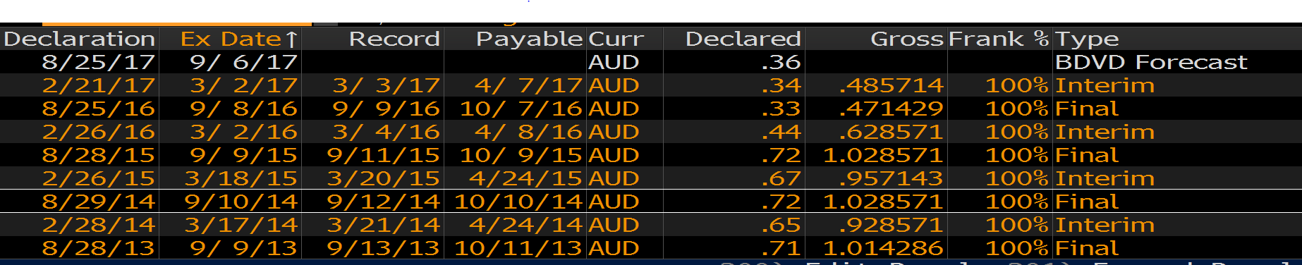
Real world example
How realistic is it to assume firms pay a constant dividend, or even a constantly growing dividend, for ordinary shares?
Here are the last few years of Woolworths Ltd’s dividends:

Slide 65
Some more about dividends
Dividends are not a liability of the firm until declared by the Board of Directors
A firm cannot go bankrupt for not declaring dividends
Dividends and taxes
Dividends are not tax deductible for a firm
Taxed as ordinary income for individuals, but in Australia individuals receive imputation credits for company tax paid

Slide 66
Valuation Based on Comparable Firms
Method of Comparables (Comps)
Estimate the value of the firm based on the value of other comparable firms or investments that we expect will generate very similar cash flows and risk in the future.
Valuation Multiple
A ratio of firm’s value to some measure of the firm’s scale or cash flow

Slide 67
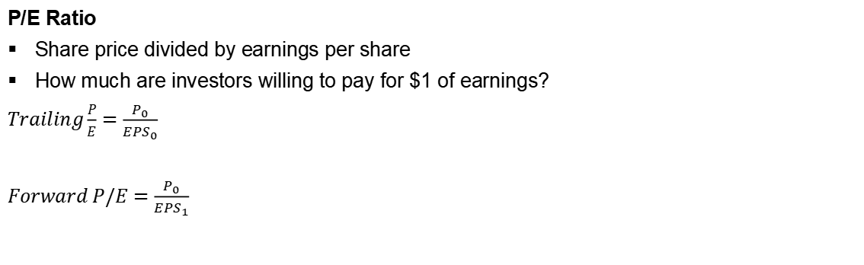
The Price-Earnings Ratio
P/E Ratio
Share price divided by earnings per share
How much are investors willing to pay for $1 of earnings?
$Trailing\frac{P}{E}=\frac{P_{0}}{{EPS}_{0}}$
$Forward P/E=\frac{P_{0}}{{EPS}_{1}}$

Slide 68
Limitations of Multiples
When valuing a firm using multiples, there is no clear guidance about how to adjust for differences in expected future growth rates, risk, or differences in accounting policies.
Comparables only provide information regarding the value of a firm relative to other firms in the comparison set.
Using multiples will not help us determine if an entire industry is overvalued.

Slide 69

Preference shares
Lower risk than ordinary shares
Given priority over ordinary shares if company is wound up
Normally given a fixed rate of dividend
Lower level of return than ordinary shares
May be cumulative or non-cumulative
No longer a major source of finance because:
no tax effectiveness
preference shares are now seen as debt when assessing borrowing capacity
We can use the perpetuity equation to value preference shares:
$$P_{0}=\frac{Div}{r_{ps}}$$
Notes:
Cumulative means investors can receive unpaid dividends in previous period

